Slide 1
Topic Modelling and Sentiment Analysis of Covid Tweets Thu Yein Oo P-2706710 Supervisor-Waddah Saeed Second Marker-Ahmet Orun

Slide 2
AGENDA
Introduction
Topic Modelling and Sentiment Analysis
Methodology
Results

Slide 3
Introduction
Global Impact: Originating in Wuhan, China, COVID-19 quickly became a global pandemic, declared by WHO on March 11, 2020. By June 30, 2020, infections surpassed 10 million, with over 503,000 deaths worldwide.
Social Media's Role: Platforms like Twitter have become crucial for real-time communication, allowing people to share opinions and information about the pandemic. It also plays a crucial role in health information distribution.
Analytical Techniques:
Topic Modelling: An NLP technique that scans documents to group similar words, useful for identifying patterns in text data.
Sentiment Analysis: Processes text data from sources like Twitter to gauge public sentiment, valuable for commerce, health, and disaster management.

Slide 4
Problem Statement, Aims and Objective.
Key Problem
-big data sets and high computationally consuming algorithms
Aim and Objective
-explore both unsupervised topic modelling algorithms and supervised classification algorithms for sentiment analysis
Research Questions
-which unsupervised model has the best accuracy to computational efficiency
-which supervised model has the best accuracy to computational efficiency
-which classification algorithm can be further parameter tuned to improve performance.

Slide 5
What is Topic Modelling
generative models with probabilistic frameworks.
organize, understand, search, summarize huge volumes of textual information.
Latent Dirichlet Allocation and BERTopic will be explored

Slide 6
What is Sentiment analysis
The process of analyzing text to determine the sentiment expressed within it
The classification of text as positive, negative, or neutral
Used in different applications like social media monitoring, customer feedback analysis and market research

Slide 7
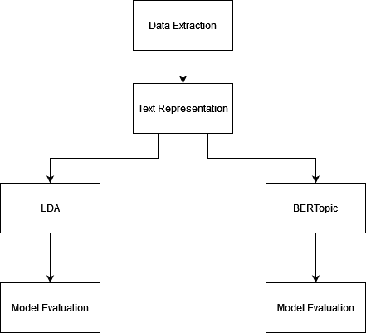
Methodology
Topic Modelling
Load data
Transform the tweets into a bag-of-word representation (word x frequency matrix)
Train the model with two algorithms: LDA and BERTopic
Evaluate the results

Slide 8
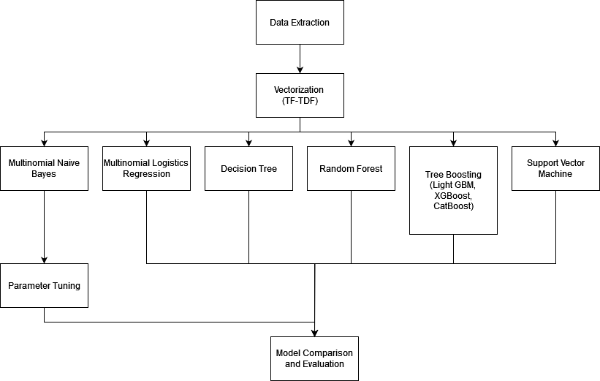
Methodology
Topic Modelling
Load data
Vectorize the tweets with TF-IDF
Train the models with multiple classification algorithms
Hyper parameter tune the suitable model
Compare and evaluate results

Slide 9
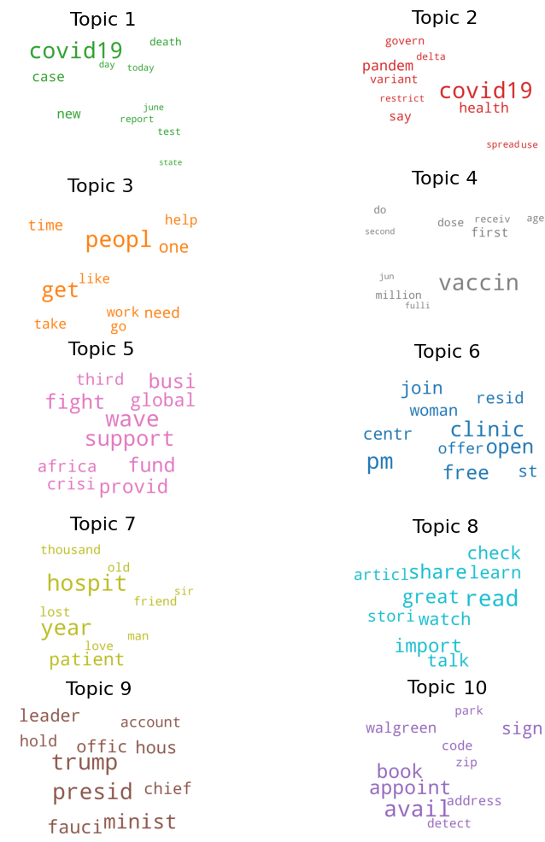
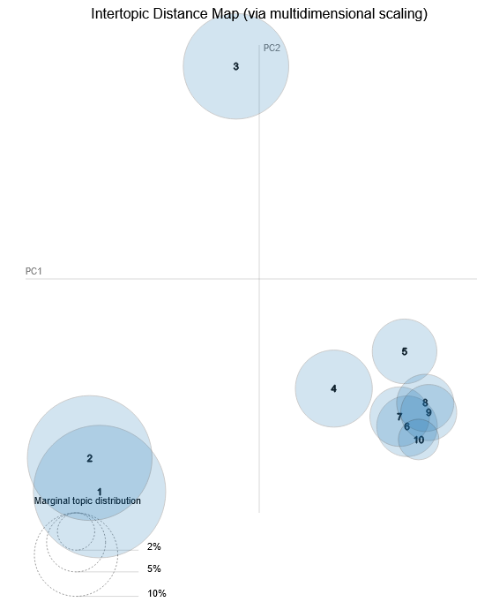
Evaluation of Topic Modelling
Evaluate models based on coherence score and perplexity (for LDA only)
Look at the intertopic distance
Topic distribution and word frequency in each topic

Slide 10
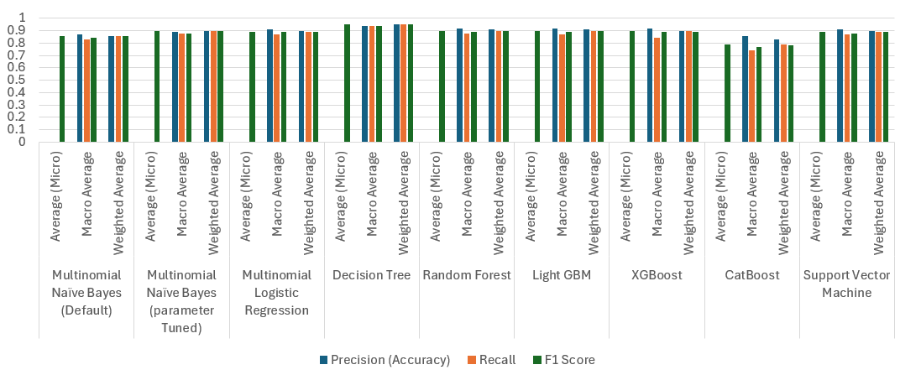
Evaluation of Sentiment analysis
Accuracy
Recall
F1 Score

Slide 11
Results
Topic Modelling
Sentiment Analysis Classification and Fine Tuning
Topic Interpretability: LDA excels in separating COVID-related topics, offering better interpretability.
Coherence Score: BERTopic scores higher in coherence but clusters all COVID topics together, which is not desirable.
Computing Time: LDA has faster computing times.
Decision Tree Model: Best accuracy, fast computing time, prone to overfitting and unseen data issues.
Multinomial Naïve Bayes (MNB): Chosen for tuning due to simplicity and computational efficiency, showing noticeable accuracy improvement post-tuning. Other models may outperform MNB with hyper-parameterization, but personal laptop limitations prevent this.

Slide 12
Conclusion & Further recommendations
Utilize LDA Features: Implement word search to allow users to find potential topics related to specific terms, aiding in trend analysis.
Expand Timeline: Use a larger dataset beyond three months for better generalization and trend analysis.
Enhance Models: Hyper-parameter tune better-performing models like tree models and support vector machines for improved classification, if resources allow.

Slide 13
THANK YOU

